Slide 1
Predicting Eligibility for NSAP Schemes Using Machine Learning
Presented By: Bhanu Sharma
College: Medicaps University
Department: Computer Science and Engineering

Slide 2
OUTLINE
Problem Statement
Proposed Solution
System Development Approach
Algorithm & Deployment
Result (Output Image)
Conclusion
Future Scope
References

Slide 3
Problem Statement
The National Social Assistance Program (NSAP) provides financial assistance to the elderly, widows, and persons with disabilities from below-poverty-line households. Manually verifying applications and assigning appropriate schemes is time-consuming and error-prone, delaying support to eligible individuals. The challenge is to build a machine learning system that can accurately predict the most appropriate NSAP scheme based on demographic and socio-economic data.

Slide 4
Proposed Solution
1. Data Collection
Dataset Source: AIKosh (Govt. of India open data portal)
Time Range: 2025–2026
Target Variable: schemecode (which NSAP scheme a person qualifies for)
Input Features:
finyear, lgdstatecode, statename, lgddistrictcode, districtname,totalbeneficiaries, totalmale, totalfemale, totaltransgender,totalsc, totalst, totalgen, totalobc,totalaadhaar, totalmpbilenumber
2. Data Preprocessing
Used IBM AutoAI for automatic:
Missing value handling
Outlier treatment
Feature selection and scaling
Features with low impact were dropped automatically
Encoding applied where needed (e.g., categorical state or gender features)

Slide 5
Proposed Solution
3. Machine Learning Algorithm
IBM AutoAI ran several models including Decision Trees, Logistic Regression, and XGBoost
The best performing model selected was:
“Random Forest Classifier”
Classification task: Multi-class prediction of scheme codes based on applicant details
Model Accuracy Achieved: 98.4%
4. Deployment
Deployed using IBM Cloud Lite’s Watson Studio Deployment Space
A REST API was generated for integration into government portals or mobile apps
No-code deployment interface was used for simplified testing
5. Evaluation
Model evaluated using:
Accuracy: 98.4%
AutoAI Leaderboard for performance comparison Cross-validation ensured robust predictions

Slide 6
System Approach
System Requirements:-
IBM Cloud Lite Account
IBM Watson Studio
AutoAI enabled
NSAP Dataset (.csv)
Libraries Used:-
AutoAI (in-built)
pandas, scikit-learn (optional for local testing)
Development Tools:-
IBM Watson Studio (for AutoAI)
Deployment Space (for REST API)
Cloud Object Storage (for dataset)

Slide 7
Algorithm & Deployment
Algorithm Selection: AutoAI automatically selects from algorithms like XGBoost, Random Forest, and Logistic Regression based
on dataset characteristics. The best performing model selected was Random Forest Classifier
Data Input: Demographic & socio-economic features like age, gender, disability status, income level, state, district , etc.
Training Process: AutoAI pipeline trained on uploaded dataset, validated using cross-validation, and ranked by performance (e.g., F1-score or accuracy).
Deployment: Best performing model is deployed as an online REST API in IBM Watson Studio deployment space.

Slide 8
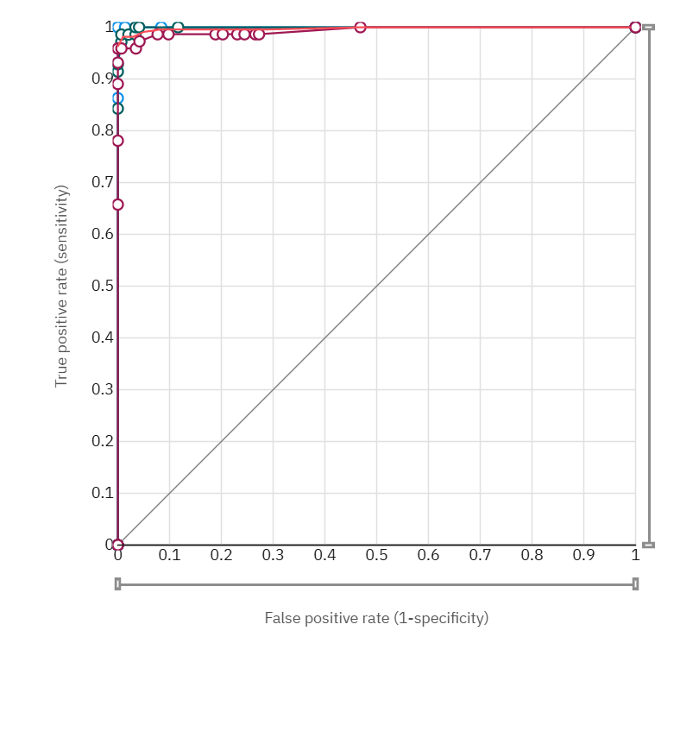
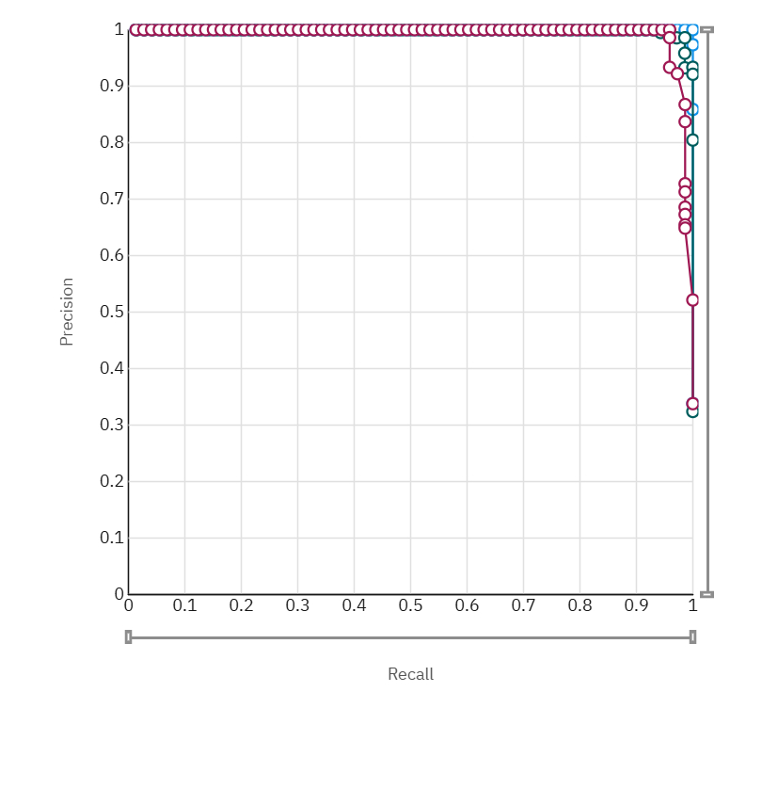
Result
Accuracy of the model is 98.4% using Random forest classifier
ROC Curve and Precision vs Recall curve

Slide 9
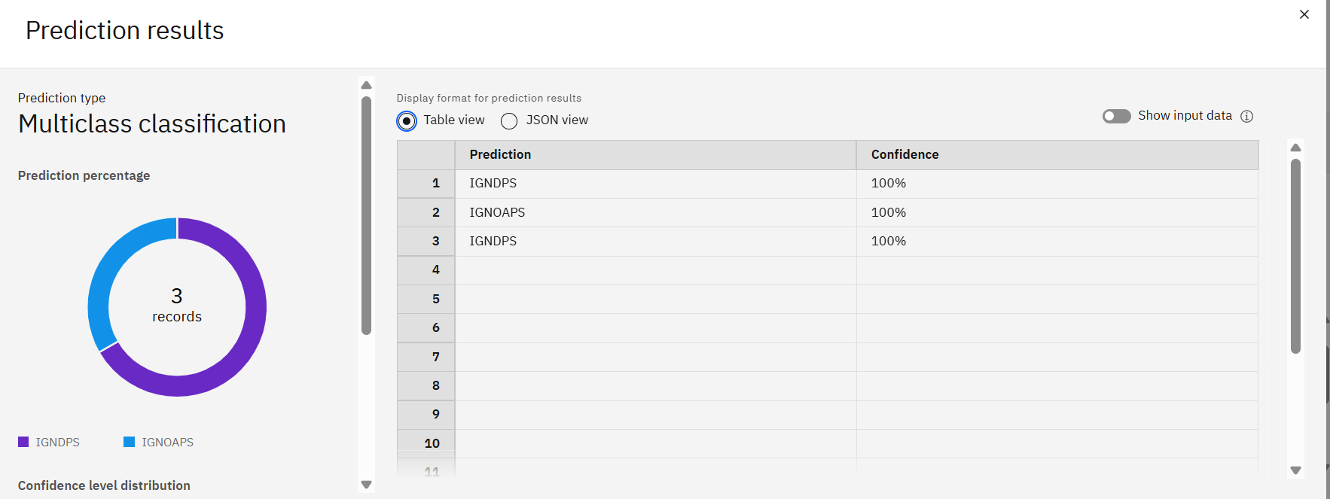
Result

Slide 10
Conclusion
Machine Learning brings a smart, automated way of assigning NSAP benefits
IBM AutoAI significantly reduced development time
Model can be easily retrained and improved with future data
High Prediction Accuracy
With an accuracy of 98.4%, the model demonstrates high reliability in real-world applications, ensuring that the majority of eligible applicants are correctly classified.
Scalable & Adaptable Solution :
The solution is built using IBM Cloud Lite, making it lightweight, cost-effective, and scalable across states or even nationwide for broader adoption.
No-Code Model Development :
IBM AutoAI enabled model training and deployment without requiring extensive coding knowledge, making it .

Slide 11
Future scope
Integrate with Aadhaar and ration card verification APIs
Add explainability layer to show “why” a scheme was assigned
Build a chatbot assistant using Watson Assistant for real-time help

Slide 12
References
AI Kosh Dataset Portal
Government of India – AI Kosh. District-wise Pension Data under the National Social Assistance Programme (NSAP).
URL:https://aikosh.indiaai.gov.in/web/datasets/details/district_wise_pension_data_under_the_national_social_assistance_programme_nsap_1.html
IBM Cloud Documentation
IBM Knowledge Center. Getting started with IBM Cloud Lite Account.
URL: https://cloud.ibm.com/docs
IBM Watson AutoAI Documentation
IBM Watson Studio. AutoAI – Automate your AI lifecycle.
URL: https://cloud.ibm.com/docs/watsonx?topic=watsonx-autoai-overview
Scikit-Learn Documentation (For understanding Random Forest Classifier)
Pedregosa, F., et al. Scikit-learn: Machine Learning in Python.
URL: https://scikit-learn.org/stable/modules/generated/sklearn.ensemble.RandomForestClassifier.html
National Social Assistance Programme (NSAP)
Ministry of Rural Development, Government of India. Overview of NSAP Schemes.
URL: https://nsap.nic.in

Slide 13
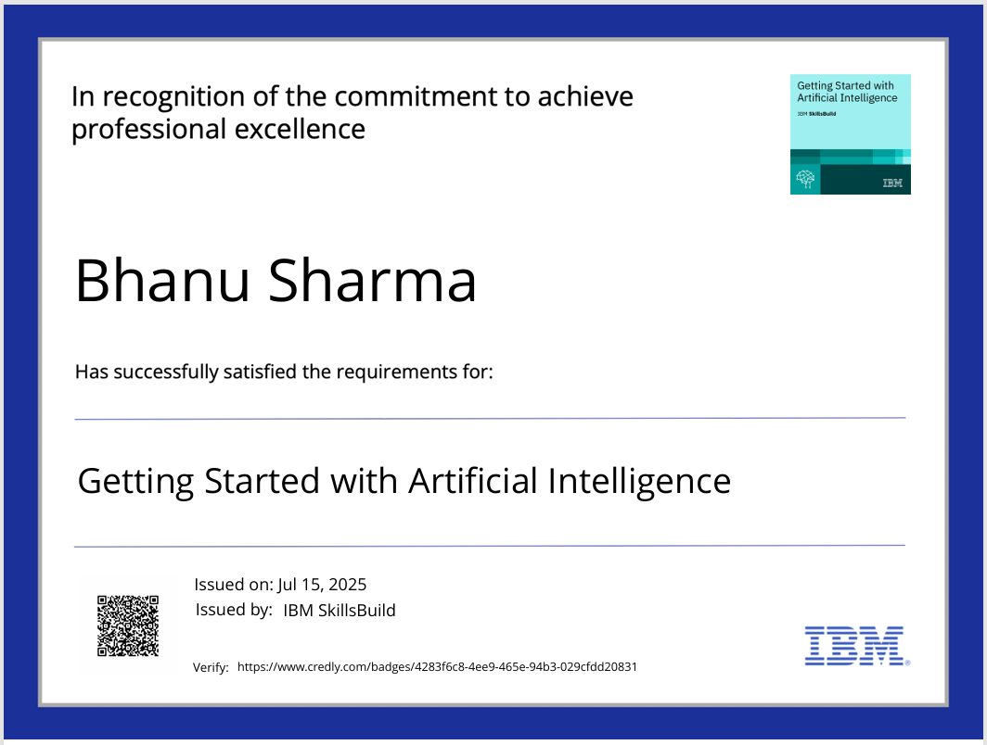
IBM Certifications

Slide 14
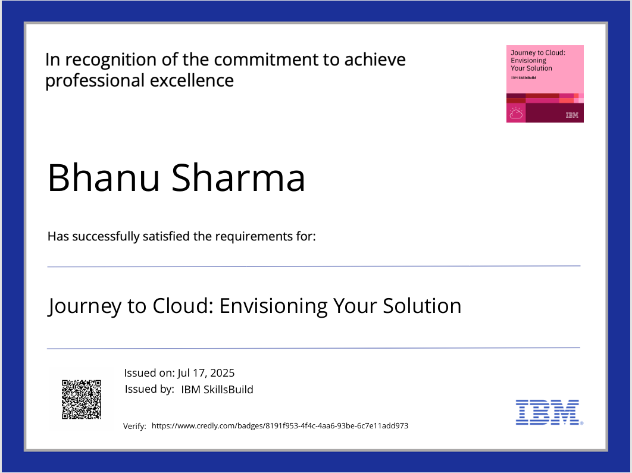
IBM Certifications

Slide 15
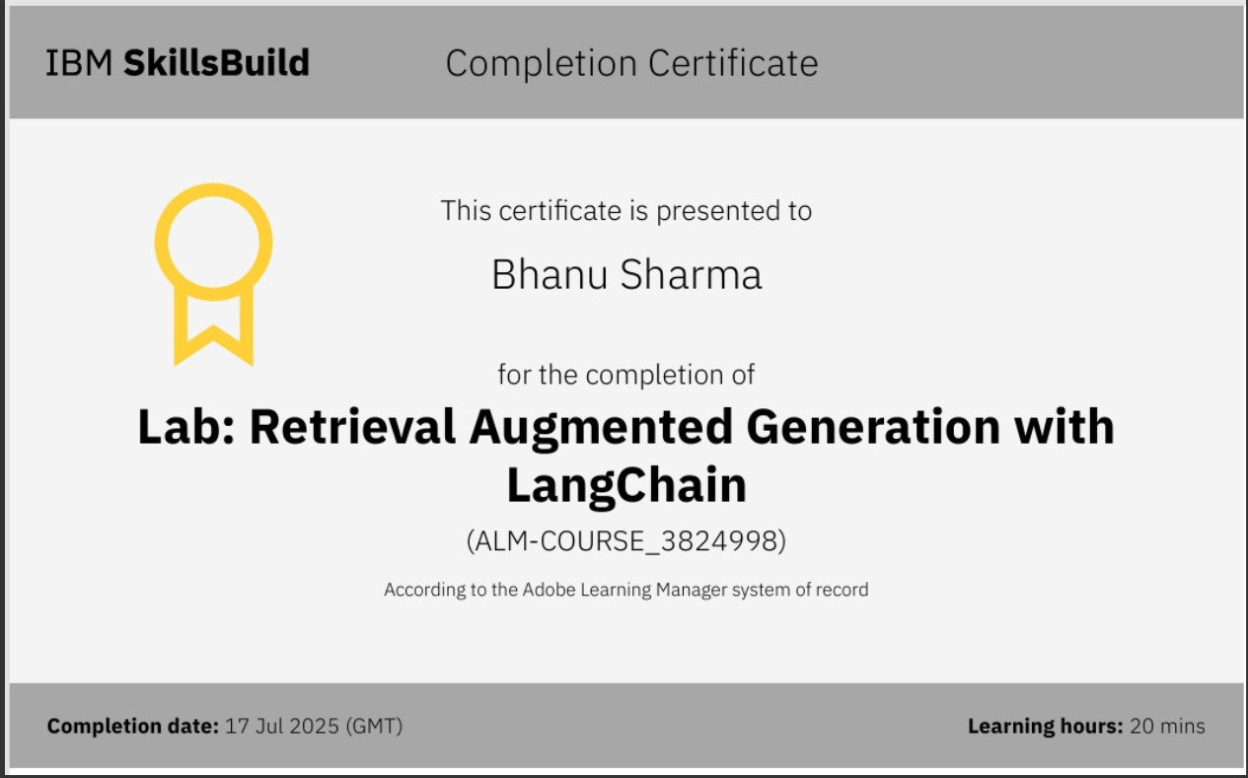
IBM Certifications

Slide 16
GitHub link:-
https://github.com/BHANUSHARMA8319/Edunet_Skillbuild_IBM

Slide 17
THANK YOU

